Slide 1
PPL Lab
Part I : Implementation of various Data Types/ Basics of C--C++ lang.
.

Slide 2
Implementation of various Data Types.
C language supports 2 different type of data types:
Primary data types:
These are fundamental data types in C namely integer(int), floating point(float), character(char) and void.
Derived data types:
Derived data types are nothing but primary datatypes but a little twisted or grouped together like array, structure, union and pointers.
Data type determines the type of data a variable will hold. If a variable x is declared as int. it means x can hold only integer values. Every variable which is used in the program must be declared as what data-type it is.

Slide 3
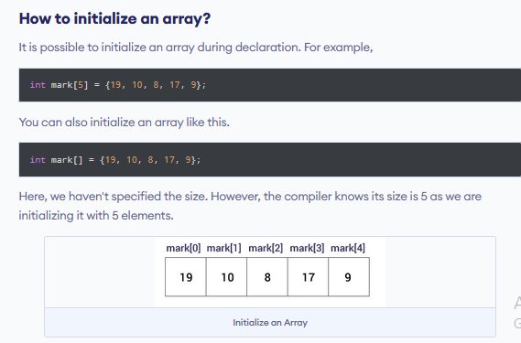
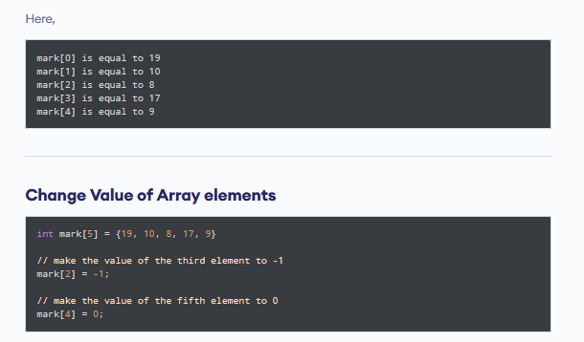
Implementation of various Data Types.

Slide 4
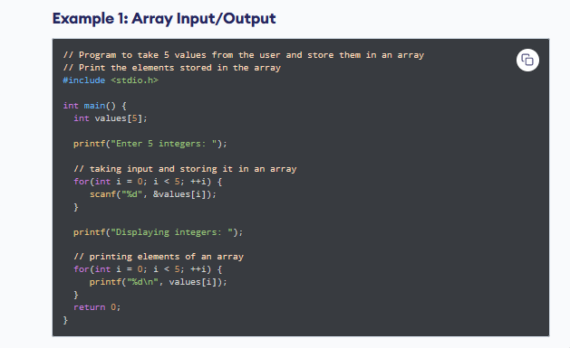
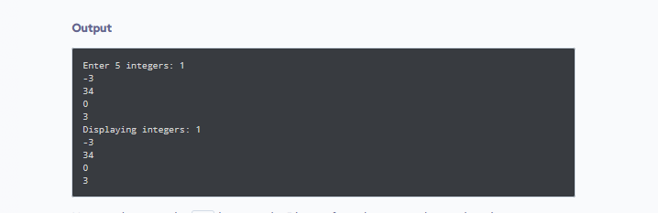
Implementation of various Data Types.

Slide 5
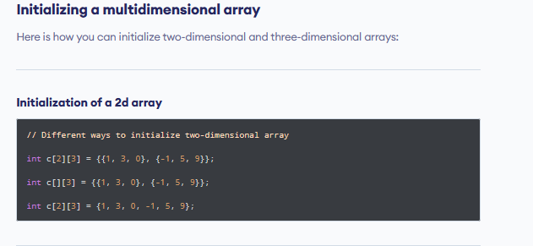
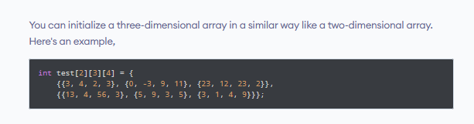
Implementation of various Data Types.
C Multidimensional Arrays

Slide 6
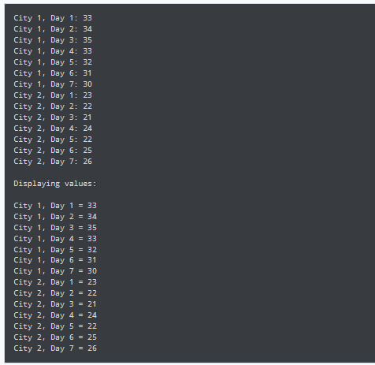
Implementation of various Data Types.
// C program to store temperature of two cities of a week and display it.
#include <stdio.h>
const int CITY = 2;
const int WEEK = 7;
int main()
{
int temperature[CITY][WEEK];
// Using nested loop to store values in a 2d array
for (int i = 0; i < CITY; ++i)
{
for (int j = 0; j < WEEK; ++j)
{
printf("City %d, Day %d: ", i + 1, j + 1);
scanf("%d", &temperature[i][j]);
}
}
printf("\nDisplaying values: \n\n");
// Using nested loop to display vlues of a 2d array
for (int i = 0; i < CITY; ++i)
{
for (int j = 0; j < WEEK; ++j)
{
printf("City %d, Day %d = %d\n", i + 1, j + 1, temperature[i][j]);
}
}
return 0;
}

Slide 7
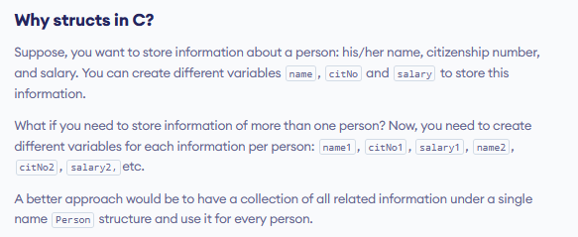
Implementation of various Data Types.

Slide 8
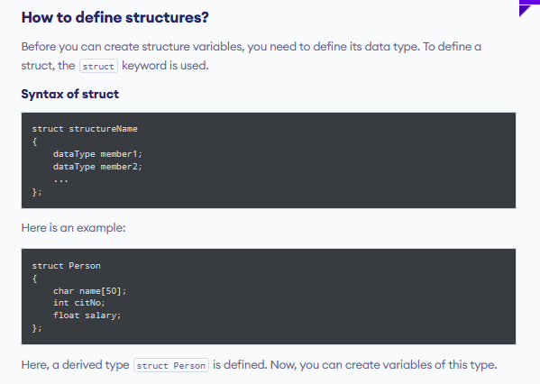
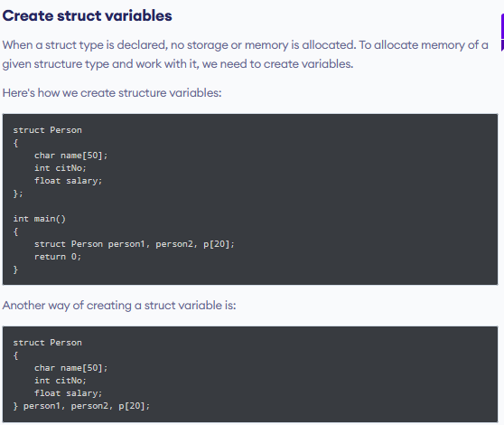
Implementation of various Data Types.

Slide 9
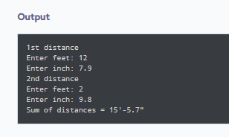
Implementation of various Data Types.
// Program to add two distances (feet-inch)
#include <stdio.h>
struct Distance
{
int feet;
float inch;
} dist1, dist2, sum;
int main()
{
printf("1st distance\n");
printf("Enter feet: ");
scanf("%d", &dist1.feet);
printf("Enter inch: ");
scanf("%f", &dist1.inch);
printf("2nd distance\n");
printf("Enter feet: ");
scanf("%d", &dist2.feet);
printf("Enter inch: ");
scanf("%f", &dist2.inch);
// adding feet
sum.feet = dist1.feet + dist2.feet;
// adding inches
sum.inch = dist1.inch + dist2.inch;
// changing to feet if inch is greater than 12
while (sum.inch >= 12)
{ ++sum.feet;
sum.inch = sum.inch - 12;
}
printf("Sum of distances = %d\'-%.1f\"", sum.feet, sum.inch);
return 0;
}

Slide 10
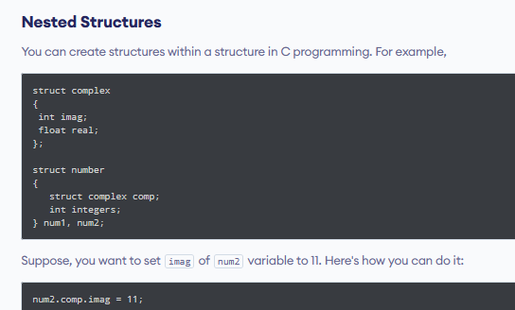
Implementation of various Data Types.

Slide 11
Implementation of various Data Types.
How you can pass structures to a function
void display(struct student s) {
printf("\nDisplaying information\n");
printf("Name: %s", s.name);
printf("\nAge: %d", s.age);
}
int main() {
struct student s1;
printf("Enter name: ");
// read string input from the user until \n is entered
// \n is discarded
scanf("%[^\n]%*c", s1.name);
printf("Enter age: ");
scanf("%d", &s1.age);
display(s1); // passing struct as an argument
return 0;
}
#include <stdio.h>
struct student {
char name[50];
int age;
};
// function prototype
void display(struct student s);

Slide 12
Implementation of various Data Types.
how you can return structure from a function:
#include <stdio.h>
struct student
{
char name[50];
int age;
};
// function prototype
struct student getInformation();
int main()
{
struct student s;
s = getInformation();
printf("\nDisplaying information\n");
printf("Name: %s", s.name);
printf("\nRoll: %d", s.age);
return 0;
}
struct student getInformation()
{
struct student s1;
printf("Enter name: ");
scanf ("%[^\n]%*c", s1.name);
printf("Enter age: ");
scanf("%d", &s1.age);
return s1;
}

Slide 13
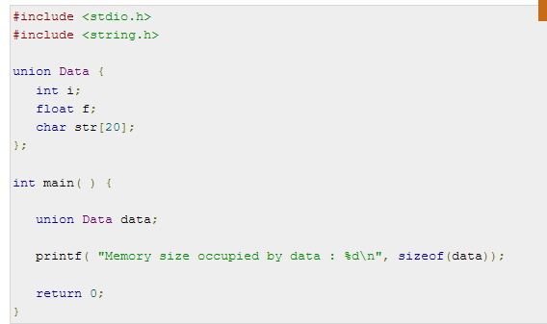
Implementation of various Data Types.
What is union in C with example?
A union is a special data type available in C that allows to store different data types in the same memory location. You can define a union with many members, but only one member can contain a value at any given time. Unions provide an efficient way of using the same memory location for multiple-purpose.

Slide 14
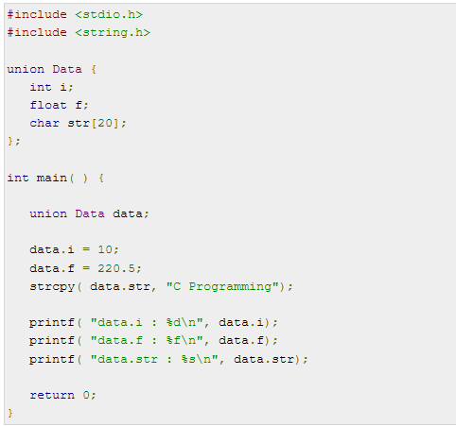
Implementation of various Data Types.
Accessing Union Members

Slide 15
Implementation of various Data Types.
Sr. No. | Key | Structure | Union
1 | Definition | Structure is the container defined in C to store data variables of different type and also supports for the user defined variables storage. | On other hand Union is also similar kind of container in C which can also holds the different type of variables along with the user defined variables.
2 | Internal implementation | Structure in C is internally implemented as that there is separate memory location is allotted to each input member | While in case Union memory is allocated only to one member having largest size among all other input variables and the same location is being get shared among all of these.
3 | Syntax | Syntax of declare a Structure in C is as follow :struct struct_name{ type element1; type element2; . . } variable1, variable2, ...; | On other syntax of declare a Union in C is as follow:union u_name{ type element1; type element2; . . } variable1, variable2, ...;
4 | Size | As mentioned in definition Structure do not have shared location for its members so size of Structure is equal or greater than the sum of size of all the data members. | On other hand Union does not have separate location for each of its member so its size or equal to the size of largest member among all data members.
5 | Value storage | As mentioned above in case of Structure there is specific memory location for each input data member and hence it can store multiple values of the different members. | While in case of Union there is only one shared memory allocation for all input data members so it stores a single value at a time for all members.
6 | Initialization | In Structure multiple members can be can be initializing at same time. | On other hand in case of Union only the first member can get initialize at a time.
.

Slide 16
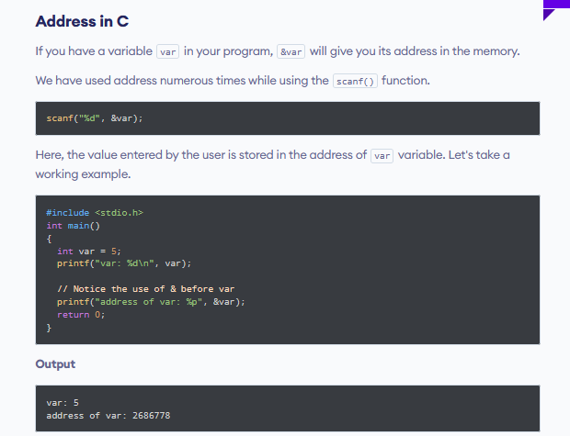
Implementation of various Data Types.
What is Pointer in C?
The Pointer in C, is a variable that stores address of another variable. A pointer can also be used to refer to another pointer function. A pointer can be incremented/decremented, i.e., to point to the next/ previous memory location. The purpose of pointer is to save memory space and achieve faster execution time.

Slide 17
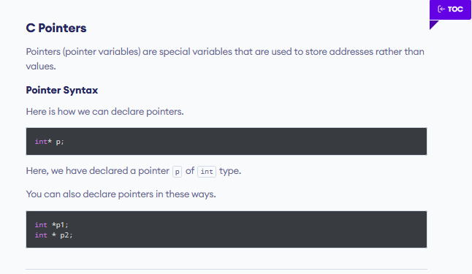
Implementation of various Data Types.

Slide 18
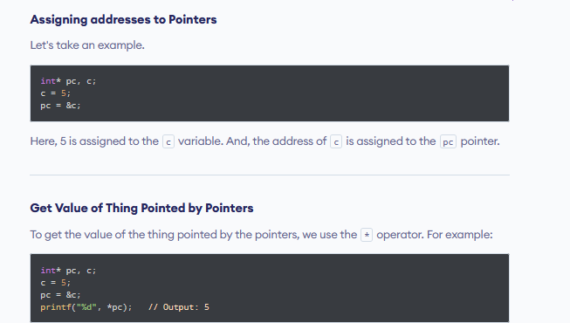
Implementation of various Data Types.

Slide 19
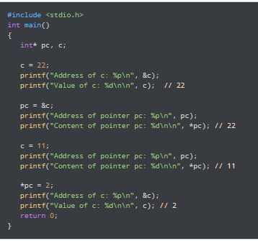
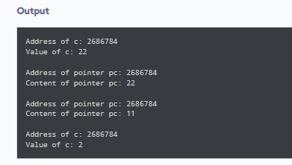
Implementation of various Data Types.

Slide 20
Assignment:
Write a program in C / C++ to find the sum and average of element of an array.
Write a program in c / c++ to print armstrong numbers between 1 to 10000
Write a program in c / c++ to print Reverse number between 1 to 100
Write a program in c / c++ to store temperature of two cities of a week and display it
Write a program in c/c++ to Sum of diagonal elements of 3x3 matrix.
Write a program in c/c++ to Count zeroes in a matrix of 4x4 matrix.
Write a program to demonstrate the use of structure and nested structure
Write a program in demonstrate that how we can pass structures to a function.
Write a program in demonstrate that how we can return structure from a function
Write a program to access the member of union data types.

Slide 21
Assignment:
11. Write a program to create, initialize, assign and access a pointer variable.
12Write a program to swap two numbers using pointers.
13. Write a program to print size of different types of pointer variables.
14. Write a Program to demonstrate example of array of pointers.
15. Write a Program to read array elements and print with addresses.

